Slide 1
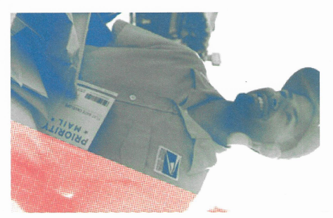
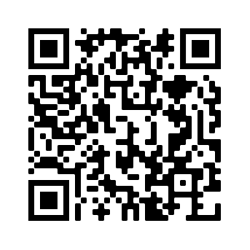
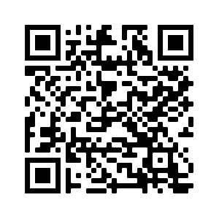
USPS IS HIRING! START THE NEW YEAR WITH AN EXCITING NEW CAREER DELIVERING FOR AMERICA!
PLEASE JOIN US FOR ONE OF OUR FREE VIRTUAL JOB FAIRS
Two convenient times!!!
Registration is Required-Scan Below
JANUARY 25, 2022 & JANUARY 27, 2022 &
FEBRUARY 1, 2022 FEBRUARY 3, 2022
12:00 PM-1 PM OR 5 PM-6PM
LEARN ABOUT ALL THE EXCITING EMPLOYMENT OPPORTUNITIES
RECEIVE STEP BY STEP INSTRUCTIONS TO COMPLETE YOUR APPLICATION
CAREER PATH POSITIONS AVAILABLE IMMEDIATELY
FEDERAL BENEFITS & COMPETITIVE PAY
City Carrier Assistant (CCA)
PSE Mail Processing Clerk (PSE MPC)
PSE Sales & SVCS/DIST Assoc (PSE SSDA)
Tractor Trailer Operator (TTO)
Rural Carrier Associate (RCA)
Mail Handler Assistant ( MHA)
USPS is an equal opportunity and top employer of Veterans

